Slide 1
Cyber Escape
Password123

Slide 2


Cyber Escape Room is an interactive online platform that combines cybersecurity challenges, logic puzzles, and real-time competitive gameplay. Players can solve progressively harder puzzles to earn XP, streaks, and badges, or compete in 1 v 1 battles where speed and accuracy determine the winner. The platform fosters critical thinking, problem-solving, and friendly competition in a gamified cyber environment.
About

Slide 3
Impact & Potential — Engages students and enthusiasts in cybersecurity learning, scalable to classrooms, clubs, or online communities.
Feasibility / Practicality — Built with Node.js, MongoDB, and web technologies; easily deployable on local machines or cloud servers.
Use cases

Slide 4

Key features
User Authentication: Secure registration and login with hashed passwords and JWT-based sessions.
Puzzle Challenges: A variety of logic and cybersecurity puzzles with hints generated via AI.
Progress Tracking: XP, levels, streaks, and badges to gamify the learning experience.
Real-Time 1v1 Battles: Players can compete in timed puzzle duels, with live score updates.
Leaderboard: Ranks players based on XP and battle performance.
Responsive UI: Modern interface using Tailwind CSS.
AI-Powered Hints: Friendly, context aware hints generated with Google Gemini AI.

Slide 5

Inspiration
The project was inspired by a desire to make learning cybersecurity and logical thinking fun, engaging and interactive. By combining gamification, real time competition, and AI generated hints, it encourages users to develop problem solving skills while having fun in a collaborative and competitive environment.

Slide 6




Nodejs
Express framework
We have chose Nodejs as our backend due to its simple structure and previous experience
We chose the express framework as to build the RESTful API
Gemini AI Studio
MongoDB
We chose Gemini AI studi for its easy implementation and ease of setup to generate hinta for the challenges
We chose MongoDB as the database to for User data and for easy integration into Nodjejs

Slide 7
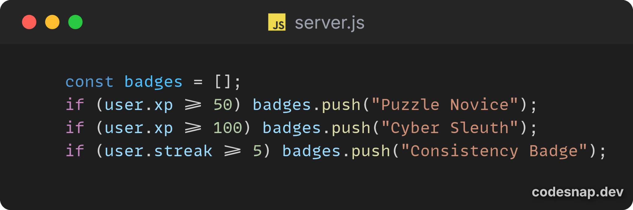
Badges
We use badges to represent achievements that a player can achieve throughout the game

Slide 8
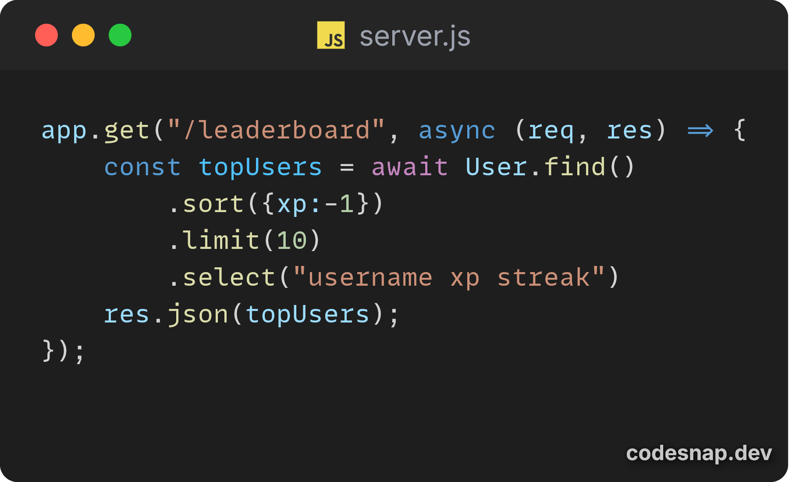
Leaderboard
We have leaderboard to help keep track of top players to create competitive environment

Slide 9
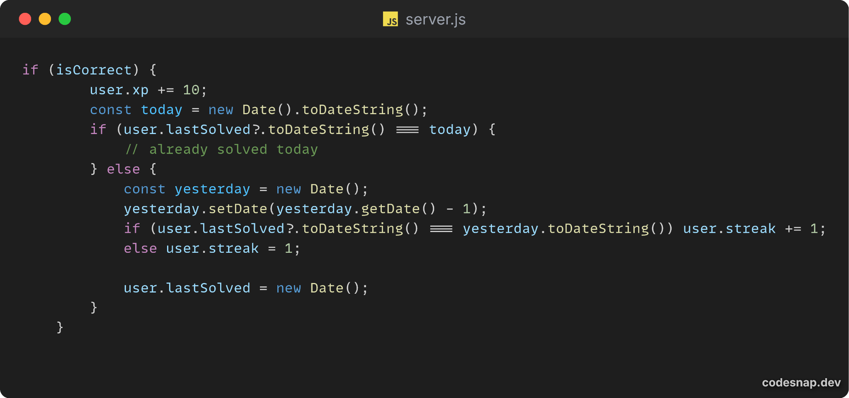
Streaks
We have leaderboard to help keep track of top players to create competitive environment

Slide 10
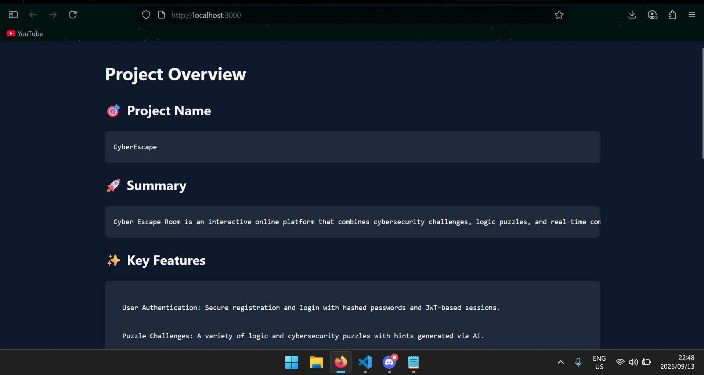
Homepage

Slide 11
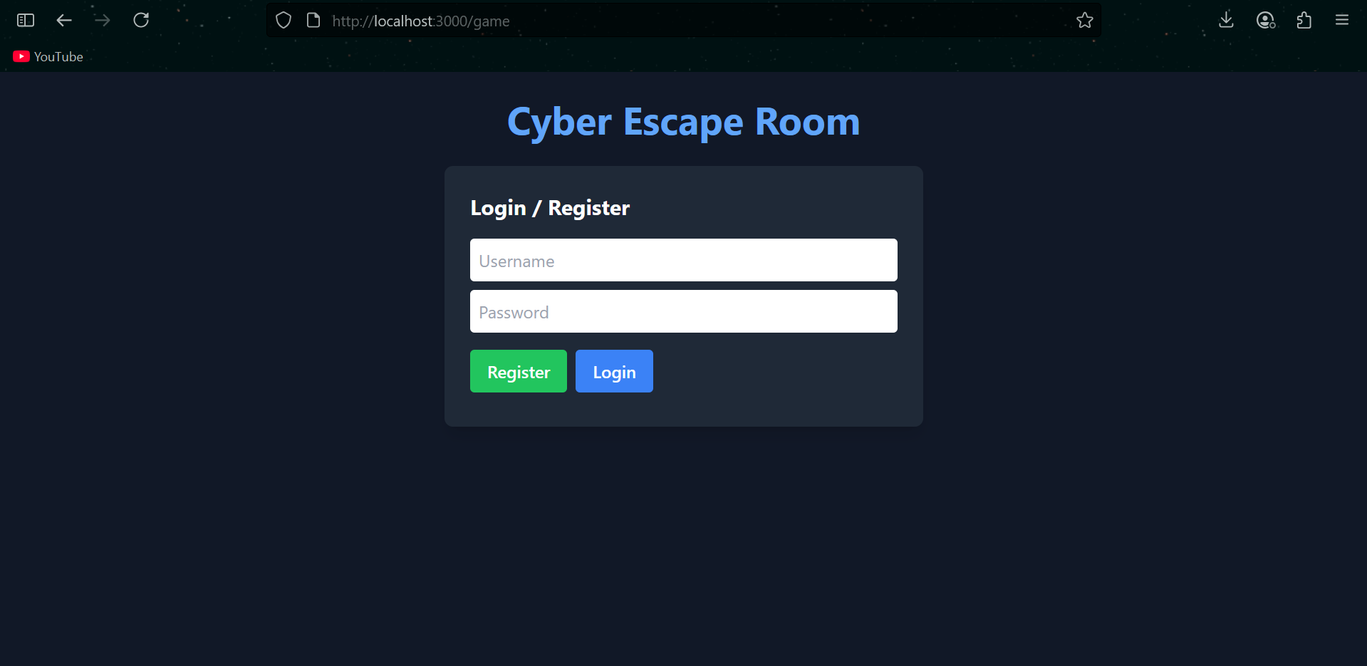
Register page

Slide 12
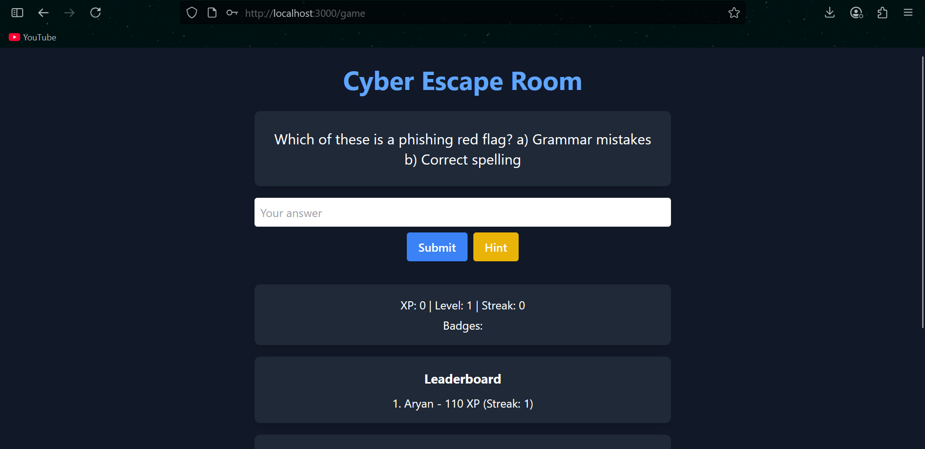
Main page

Slide 13

Demo

Slide 14
Future Improvements
1. Add more diverse puzzle types, including multimedia challenges (images, audio, or code snippets).
2. Implement real time multiplayer chat and reactions during battles.
3. Introduce AI-generated adaptive difficulty to tailor puzzles to each user's skill level.
4. Add badges, achievements, and seasonal competitions to increase engagement.
5. Create a mobile friendly interface and offline mode for solo practice.
6. Integrate analytics to track user progress and highlight areas for learning improvement.

Slide 15

ADVANTAGES
Interactive Learning – Provides a fun and engaging way to learn cybersecurity concepts and problem-solving skills.
AI-Driven Hints – Integrated AI (Google Gemini) offers context-aware hints without giving away answers, helping users learn gradually.
Web-Based & Accessible – Fully web-based, no installation required beyond Node.js and MongoDB; works on any modern browser.
Scalable & Extensible – Built with Node.js and MongoDB, allowing easy expansion with more puzzles, battle modes, or AI features.

Slide 16
Thank You

Slide 17

Slide Chef

